Slide 1
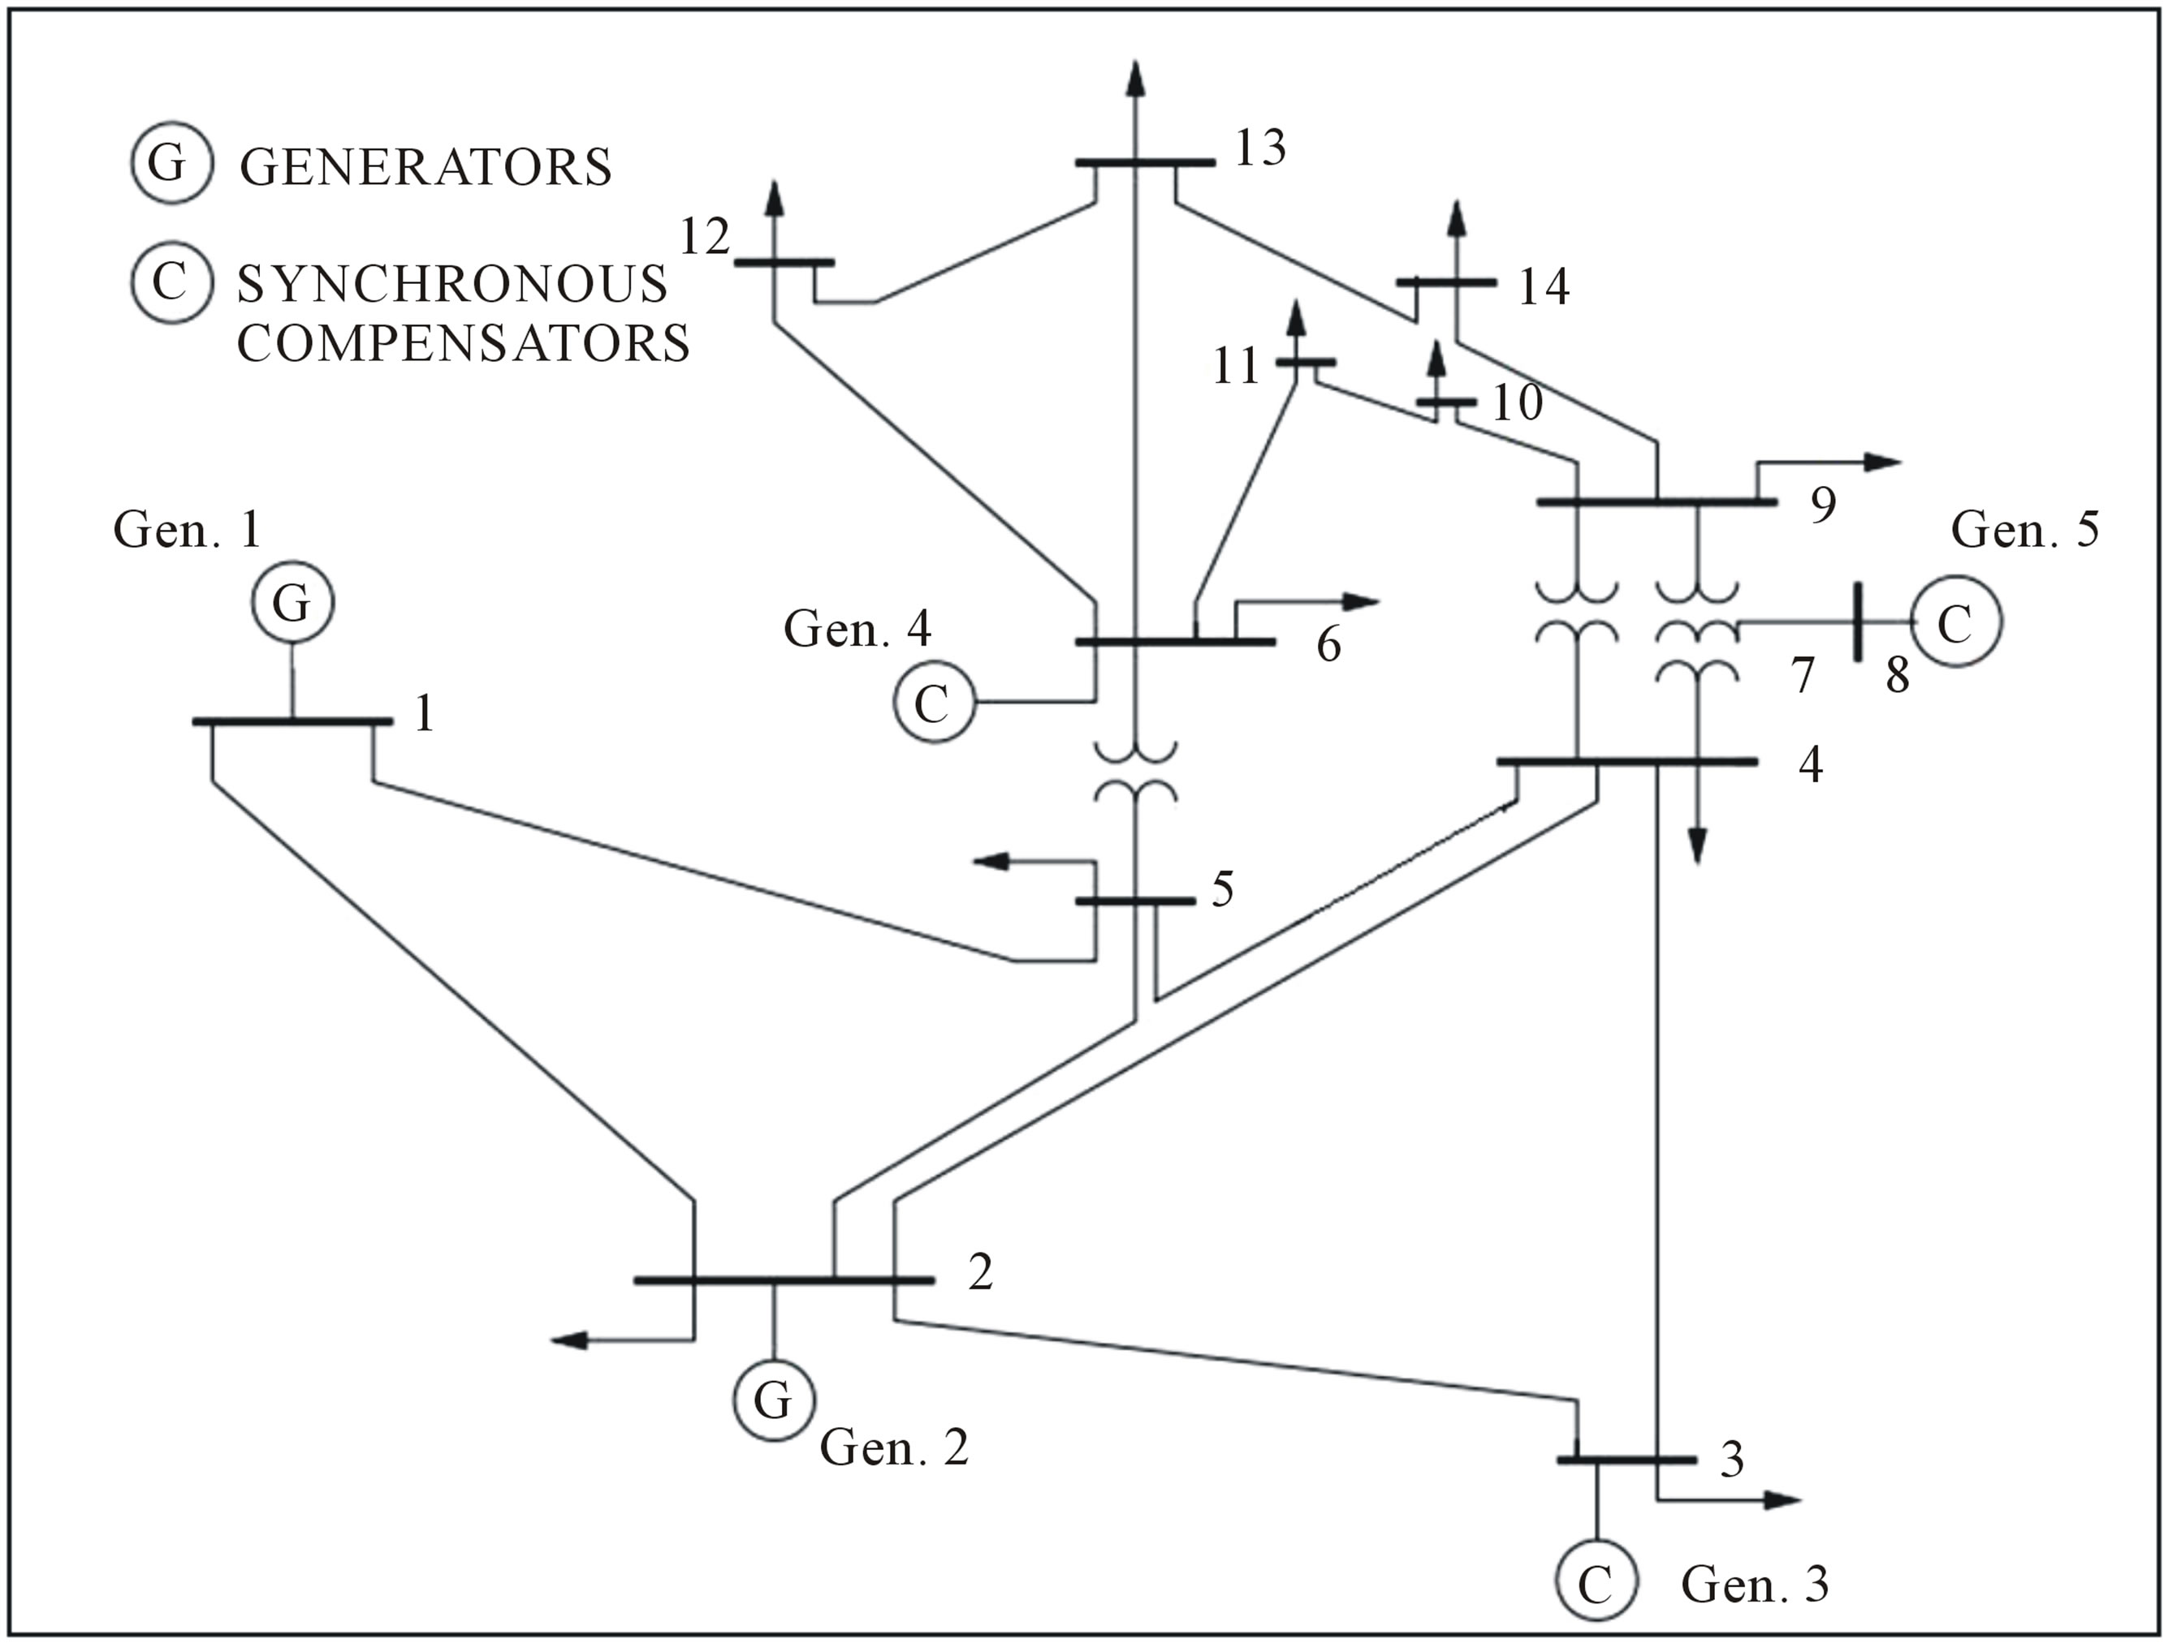
Community 3
Community 2
Grid connection
Community 1

